Slide 1
HUREM Streamline your HR Workflow

Slide 2
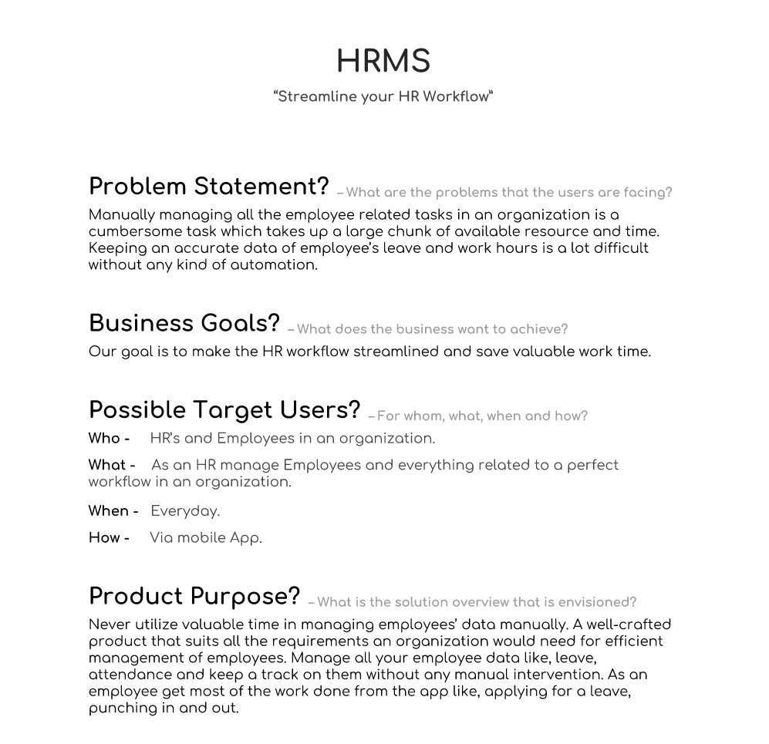
Problem statement
Manually managing all the employee related tasks in an organization is a cumbersome task which takes up a large chunk of available resource and time.
Keeping an accurate data of employee’s leave and work hours is a lot difficult without any kind of automation.

Slide 3
Business Goal
Our goal is to come up with a product that streamlines employees and HR workflows and
save time. This product can be utilized for various tasks such as attendance, leaves, payroll
and communication.

Slide 4
Design Methodology
User recruitment
Deciding Questionnaire
User interviews
Interview Results
Affinity analysis
Making personas

Slide 5
User Research

Slide 6
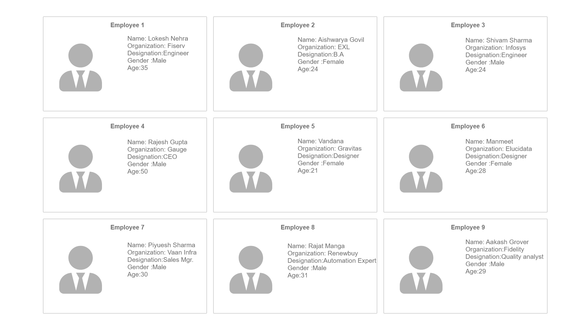
User Recruitment Employees

Slide 7
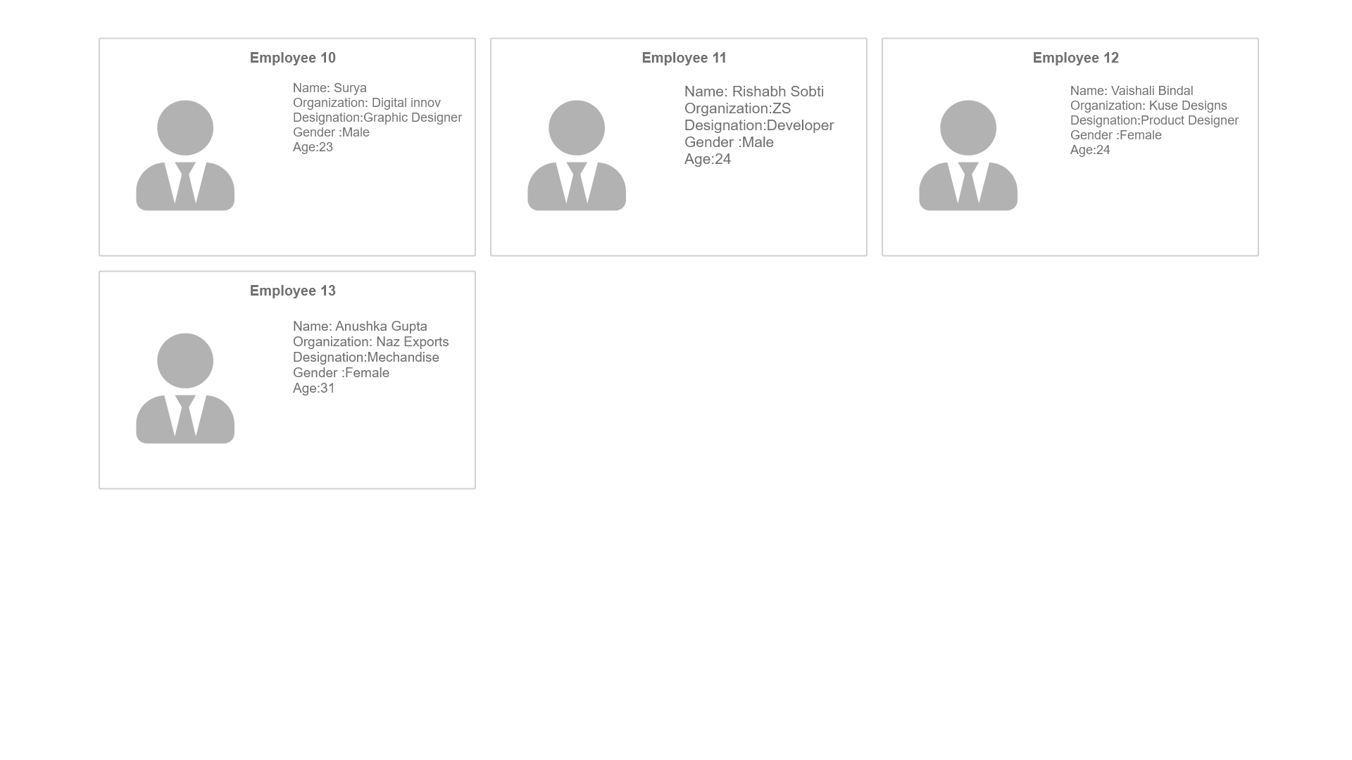

Slide 8
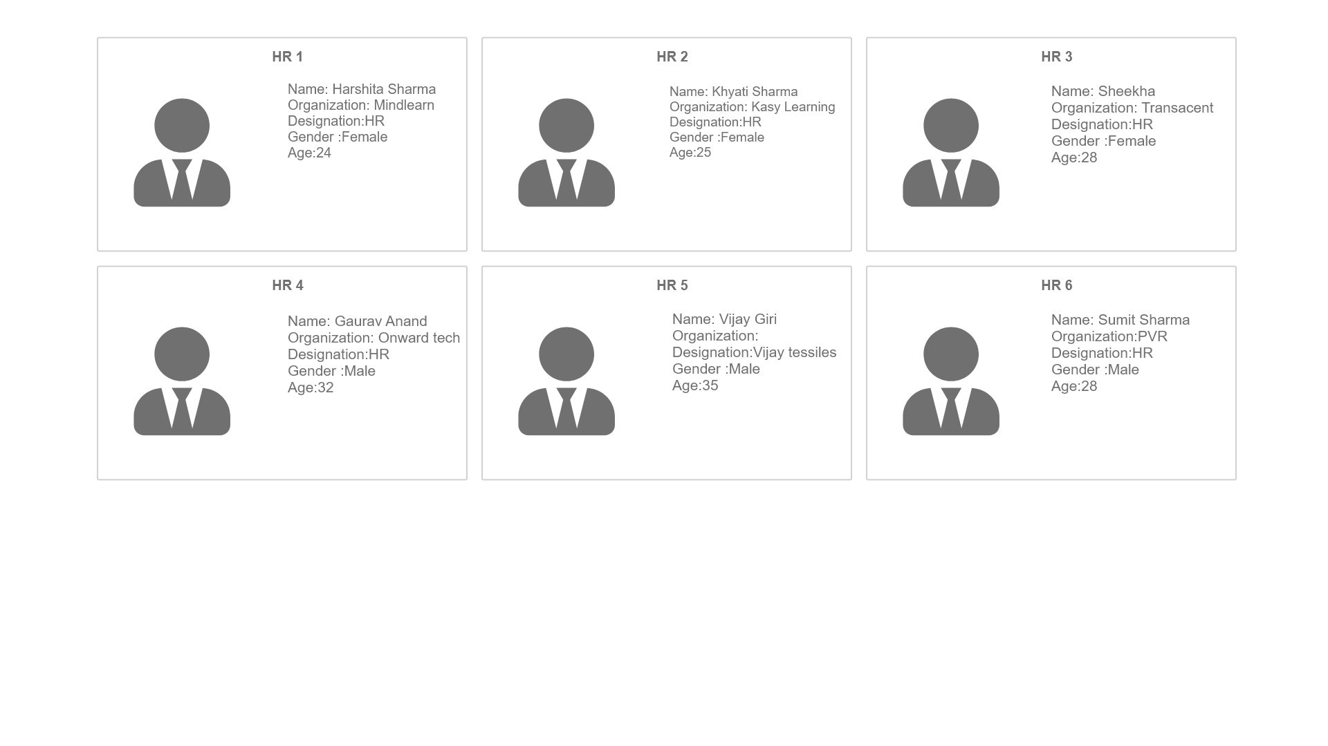
HR Demographics

Slide 9
Questionnaires

Slide 10
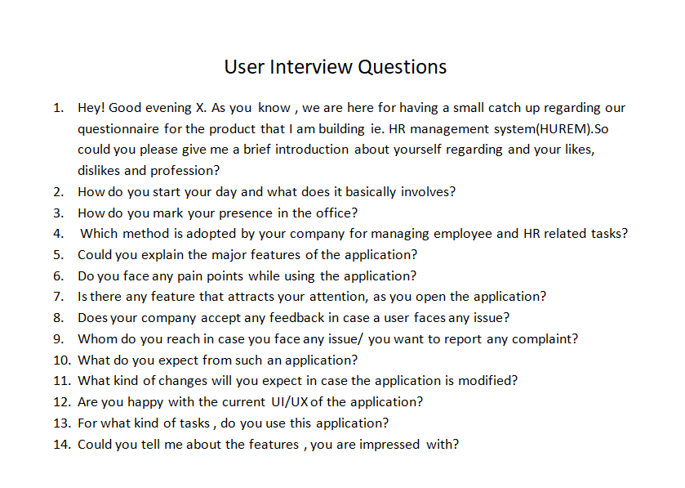
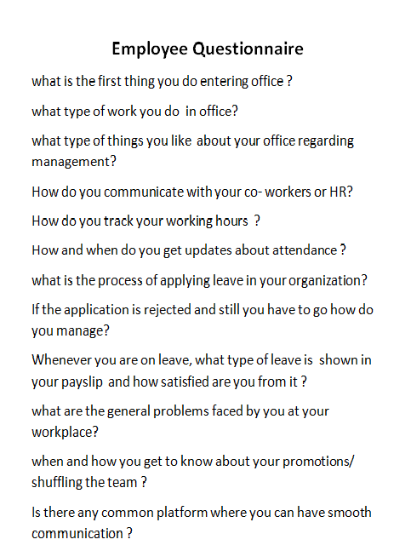
Employee Questionnaire
1. What does your daily routine at office involves?
What is the formal mode of communication in your organisation?
How does your company streamline various processes involved in the organisation?
Tell me about the features of the product?
Which feature is the most prominent in your company’s portal?
Whom do you reach in case you face any issue regarding the company or the portal?
Are there any features you wish this product had?

Slide 11
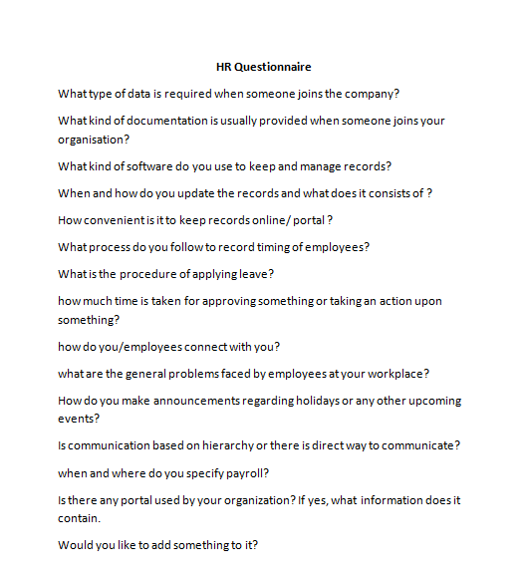
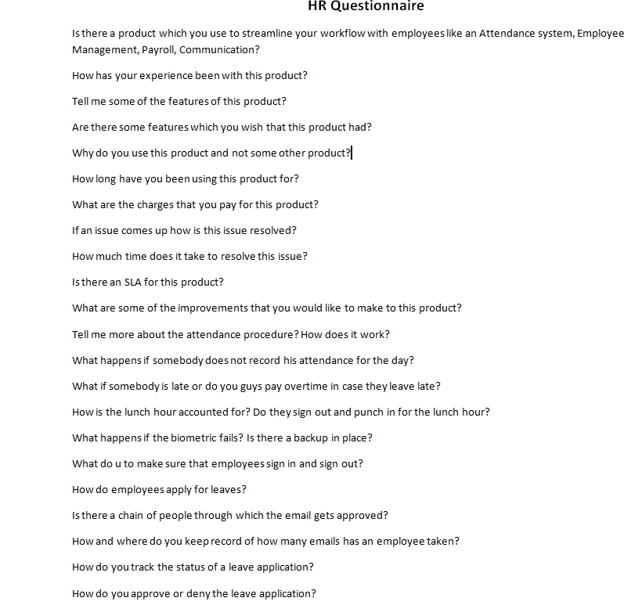
HR Questionnaires Major questions which were asked during the interview are as follows:
What kind of software is used for keeping and managing all those records?
How do you announce about various events and holidays within the organisation?
Is there any portal used by your organisation? Tell me something regarding its features?
Is communication based upon hierarchy or there is any direct way to communicate?
What are the various pain points do you face while managing all these stuffs?
How convenient is it to maintain those records online?
How do you and other employees apply leave? What is the hierarchy of processes involved?
Notes:
Put questioannaire template instead of just questions
Add title KEY QUESTIONS : 7-9 Questions

Slide 12
Mock Interview
Brief
Add photo

Slide 13
User Interviews
Page breaker

Slide 14
User Interviews
Collage of all interview images

Slide 15
User interview results
Excel snippets

Slide 16
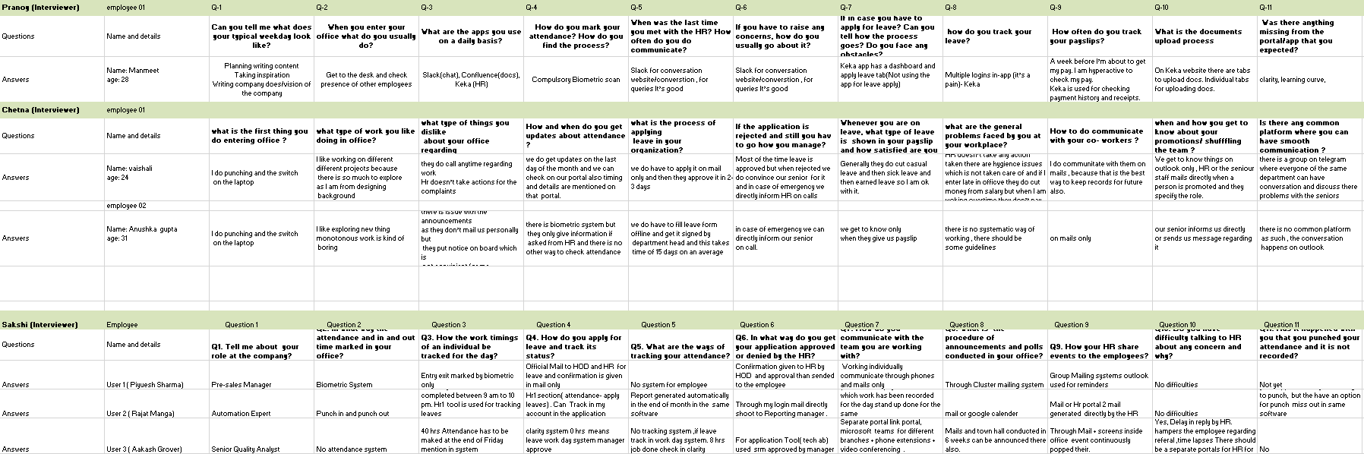
Employee Interview

Slide 17
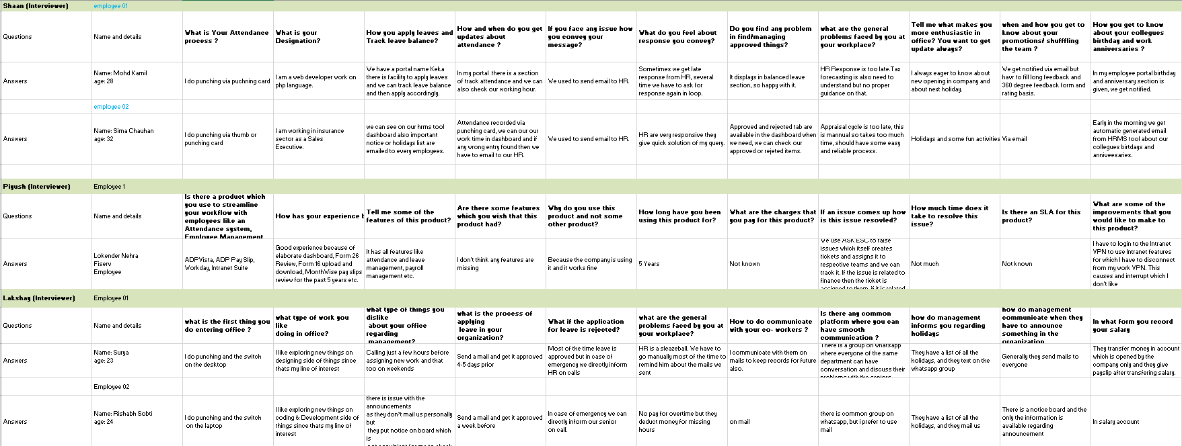
Employee Interview
Notes:
Rashika and Sandey’s Excel

Slide 18
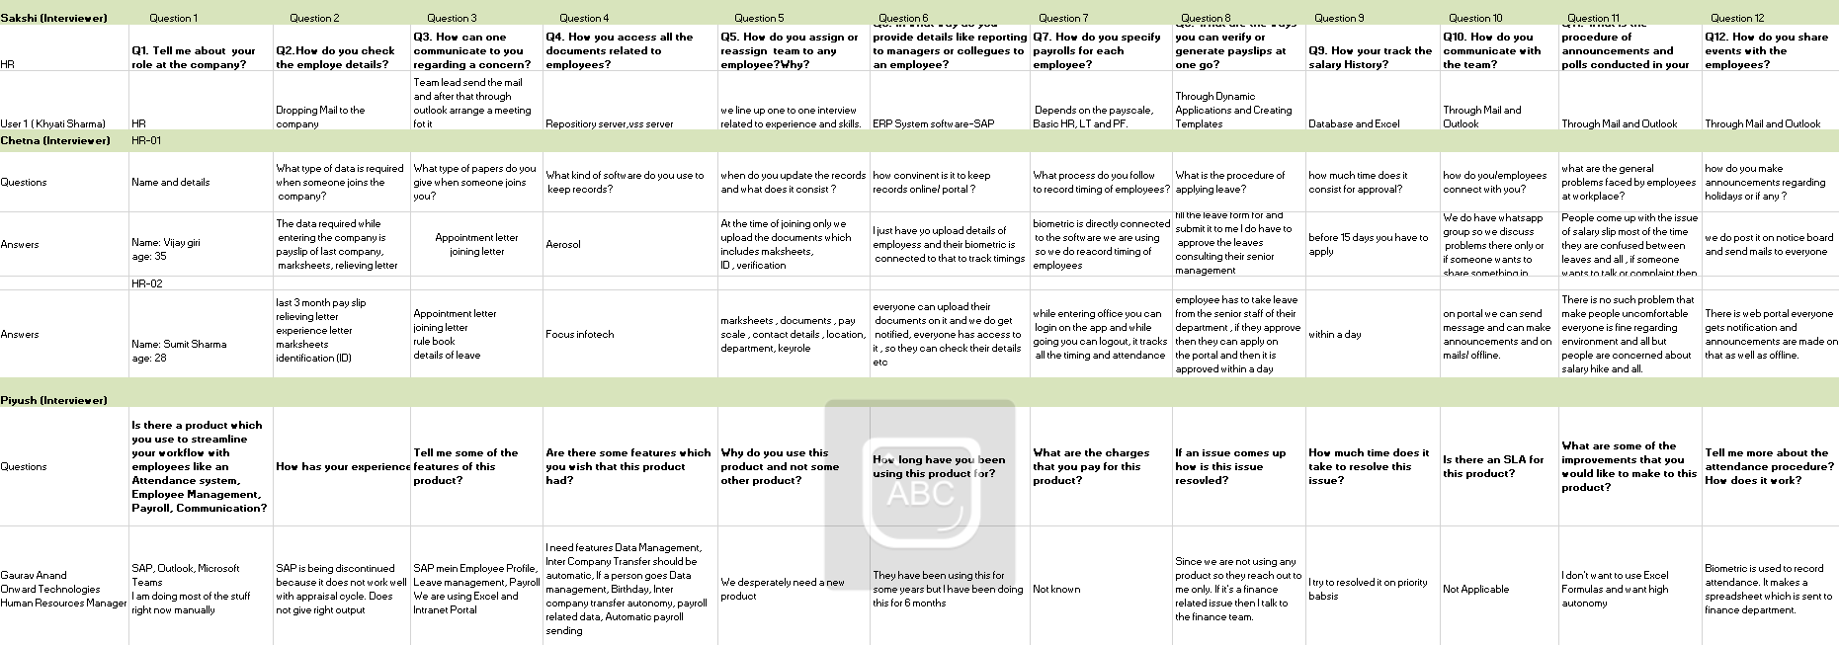
HR Interview

Slide 19
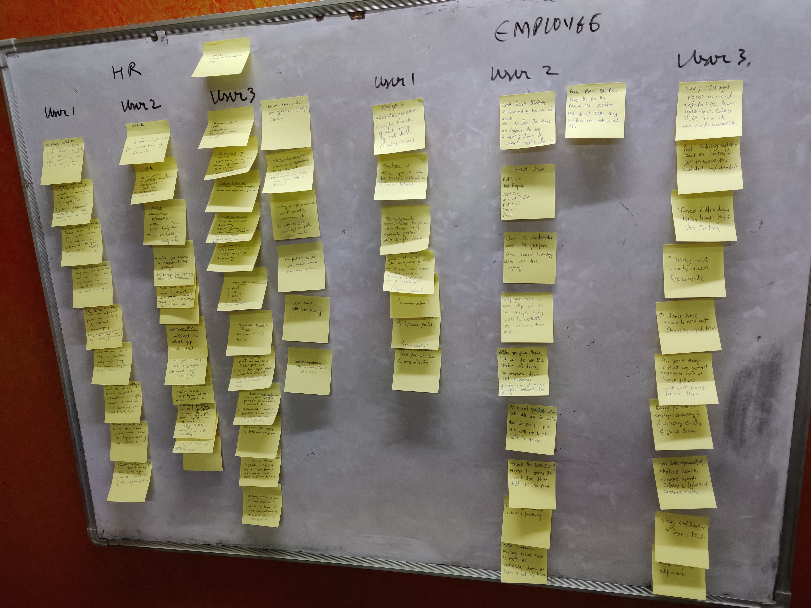
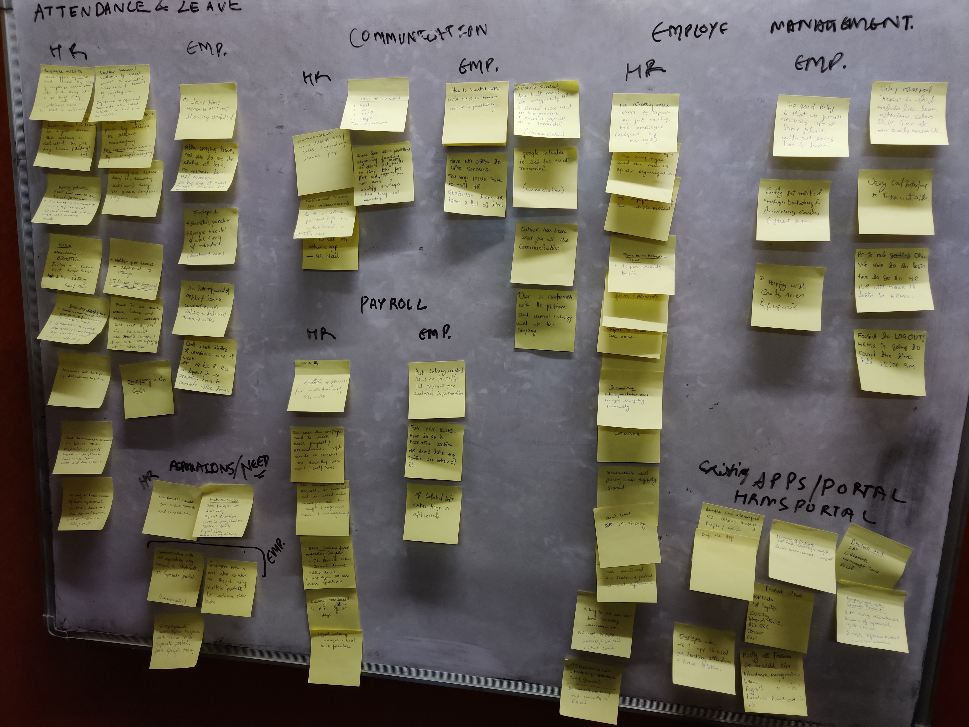
Affinity Analysis
Classroom activity

Slide 20
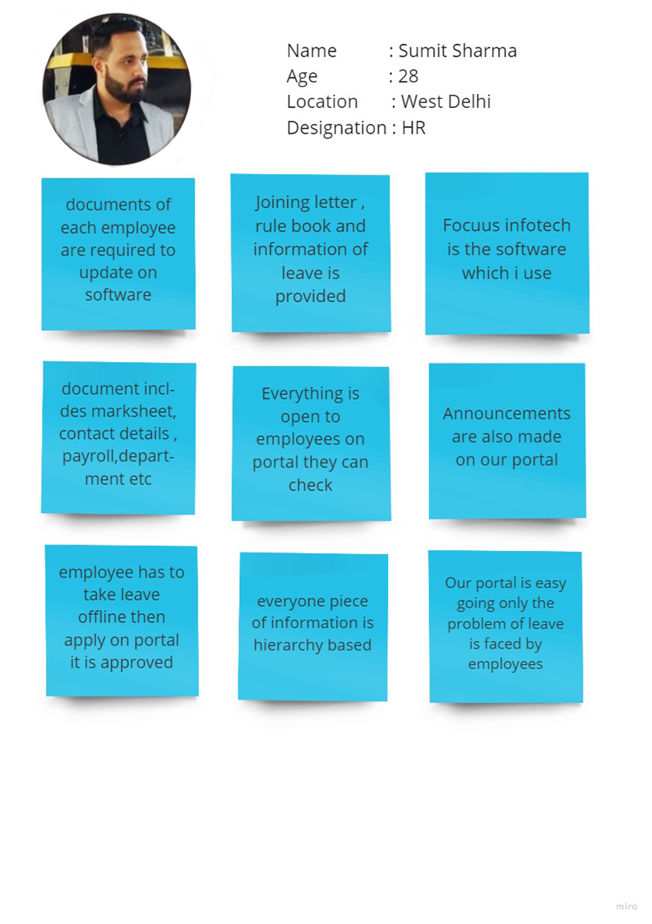
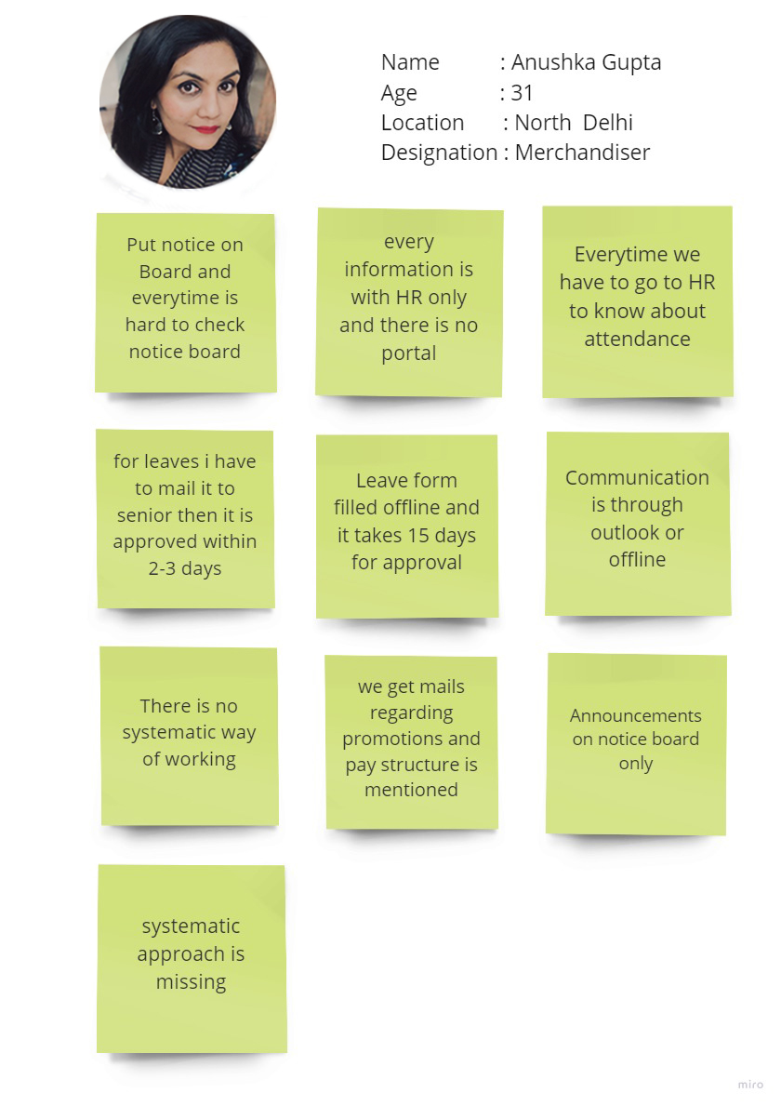
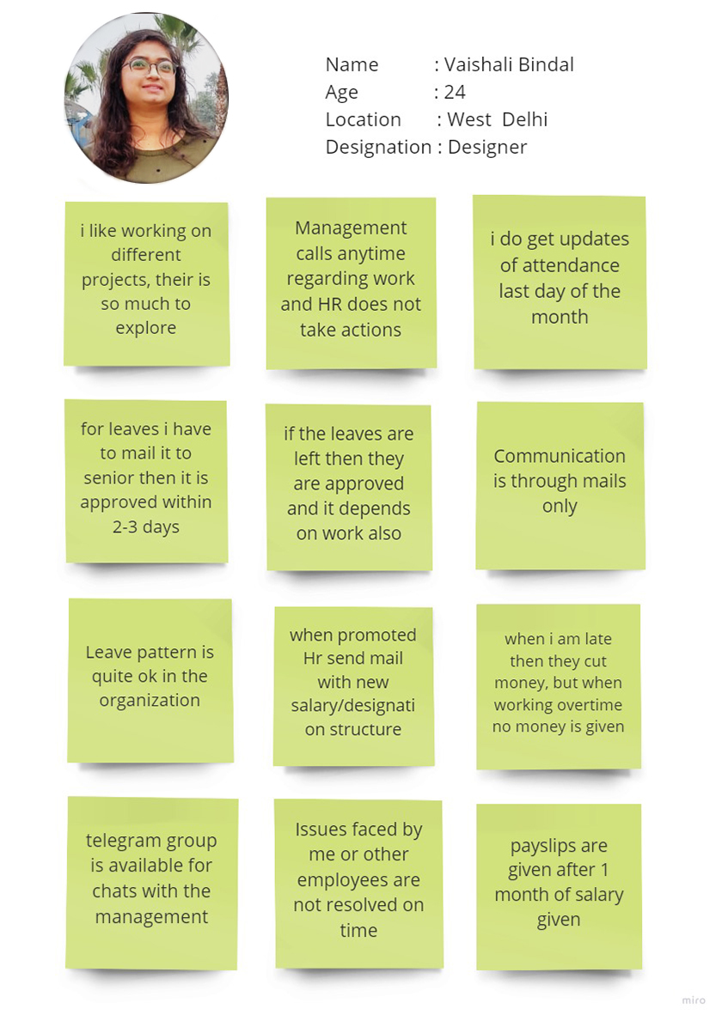
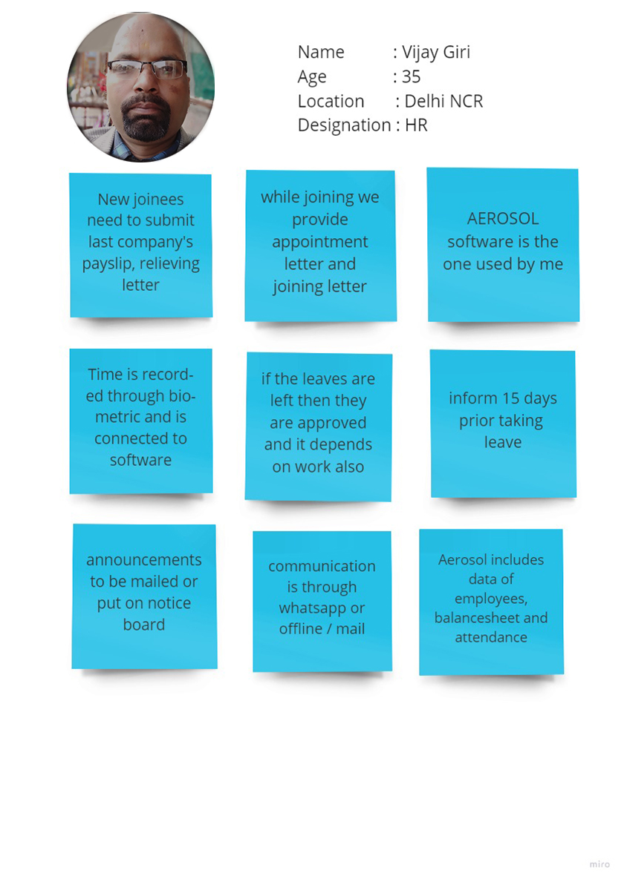
Affinity Analysis

Slide 21
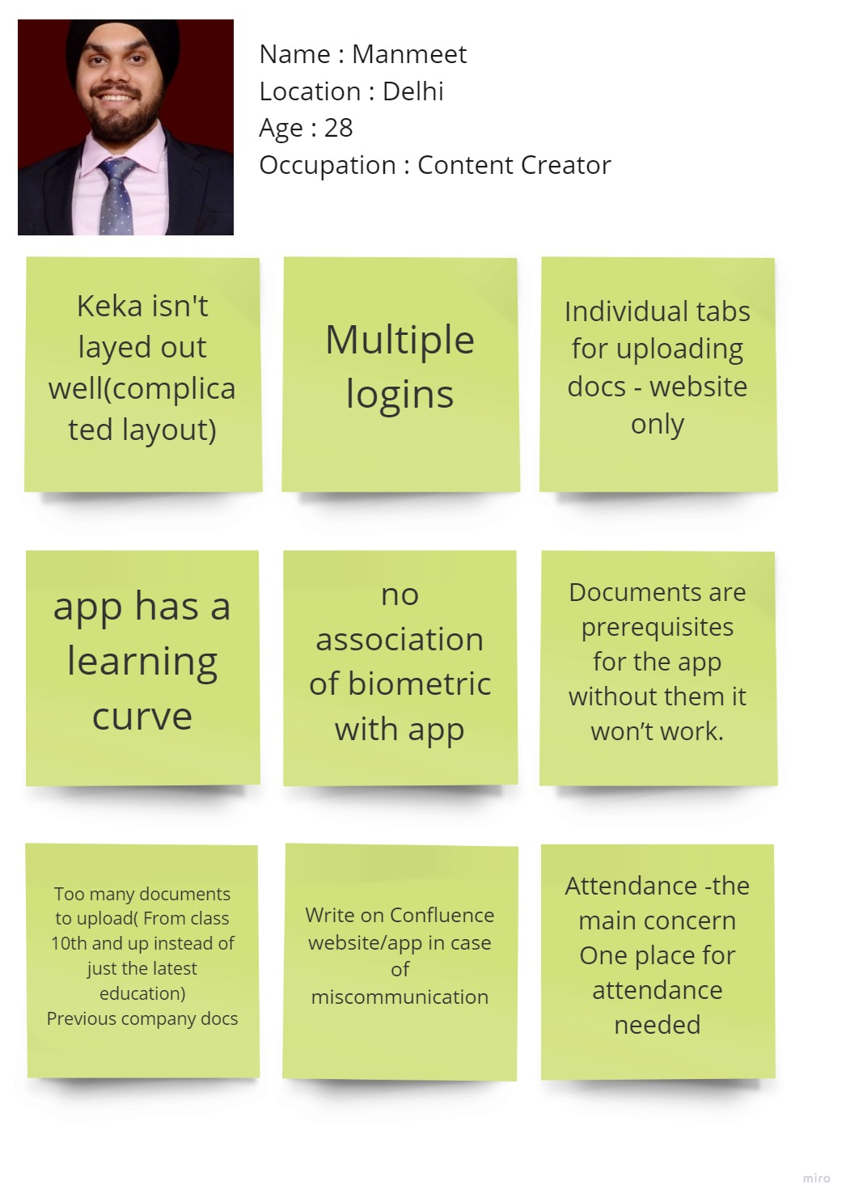
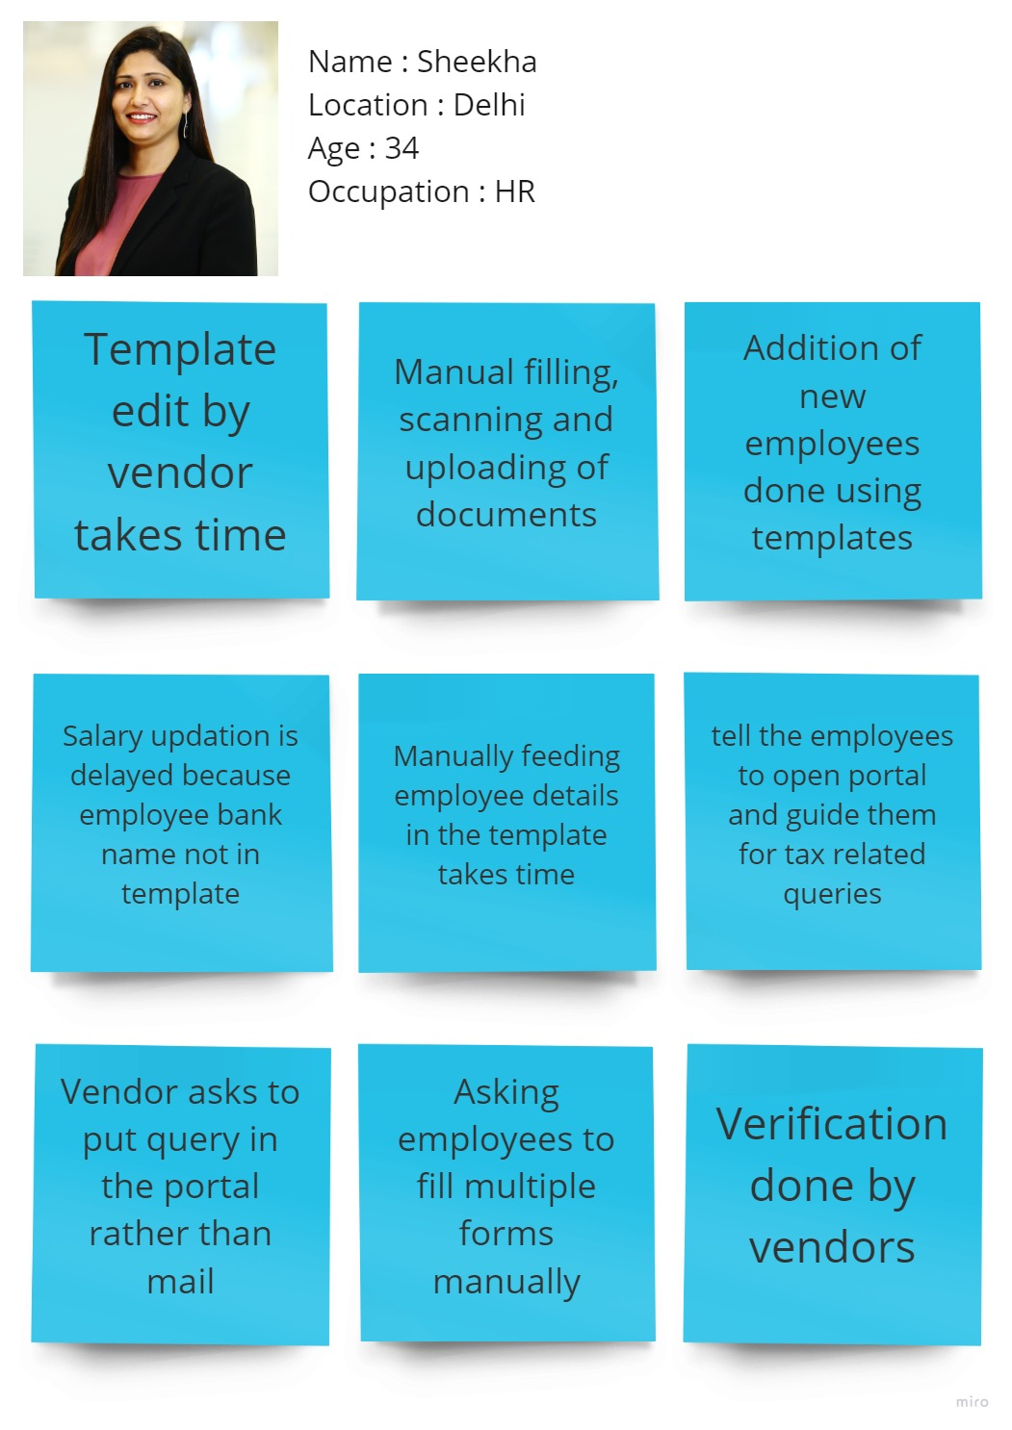

Slide 22
Personas of Interviewed users

Slide 23
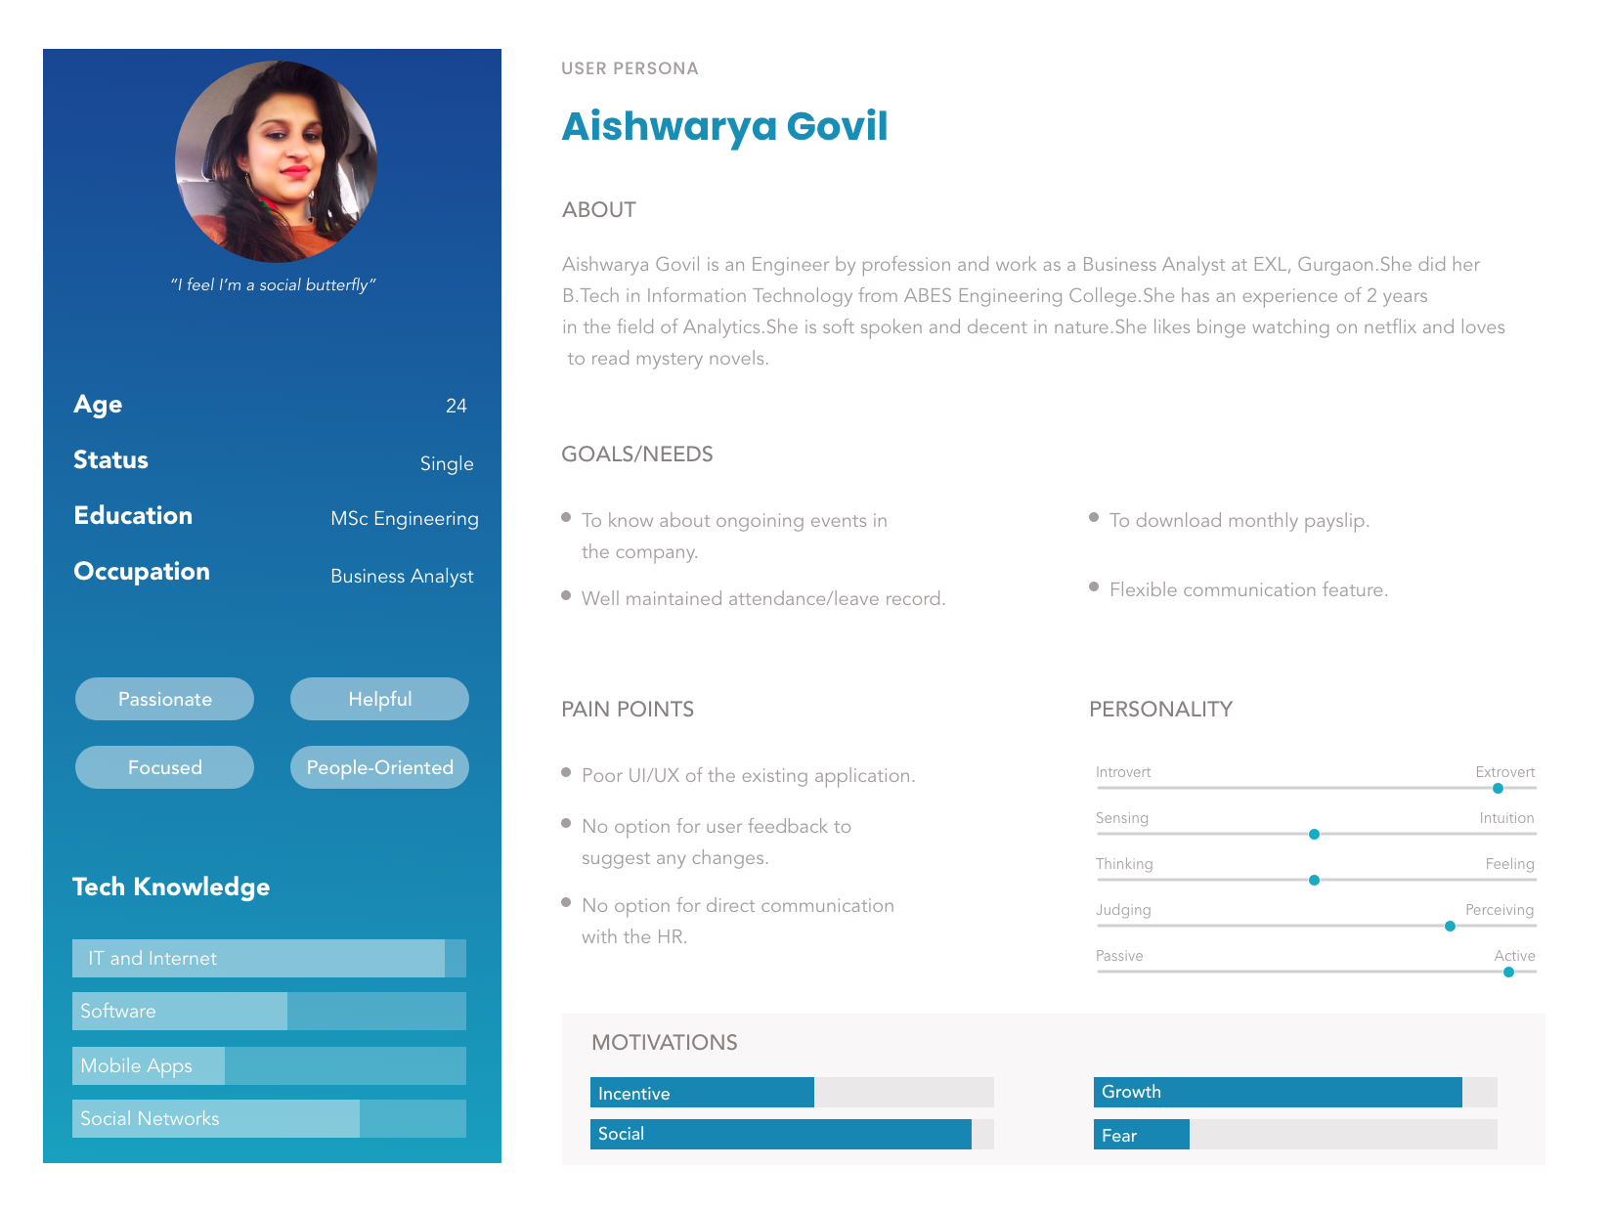
Persona – 1 (Employee)

Slide 24
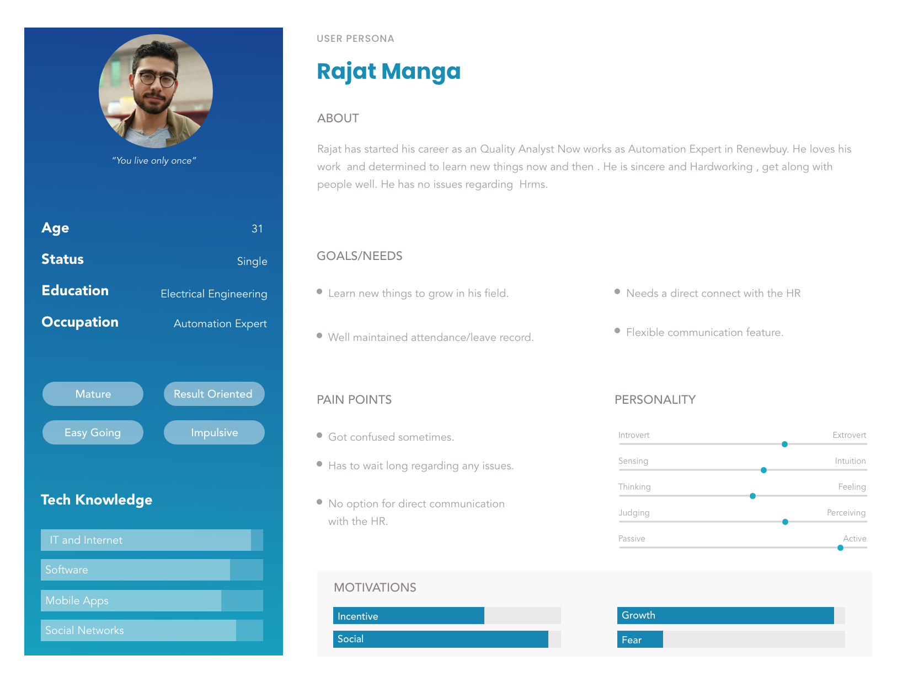
Persona – 2 (Employee)

Slide 25
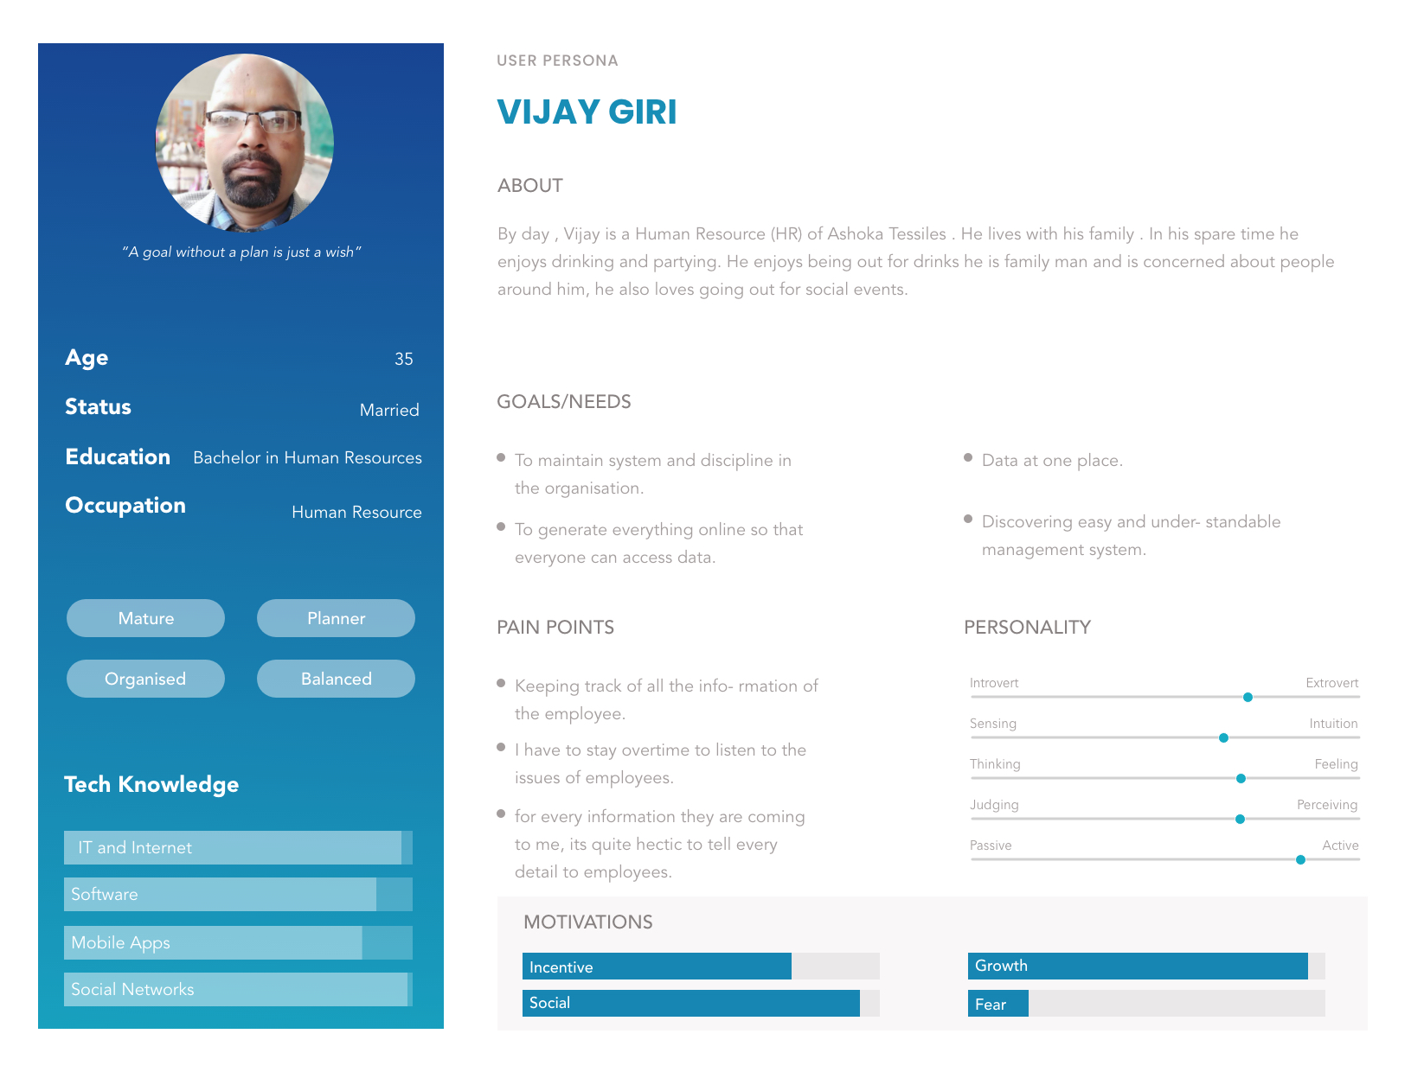
Persona – 3 (HR)

Slide 26
Key Use Case Scenarios

Slide 27
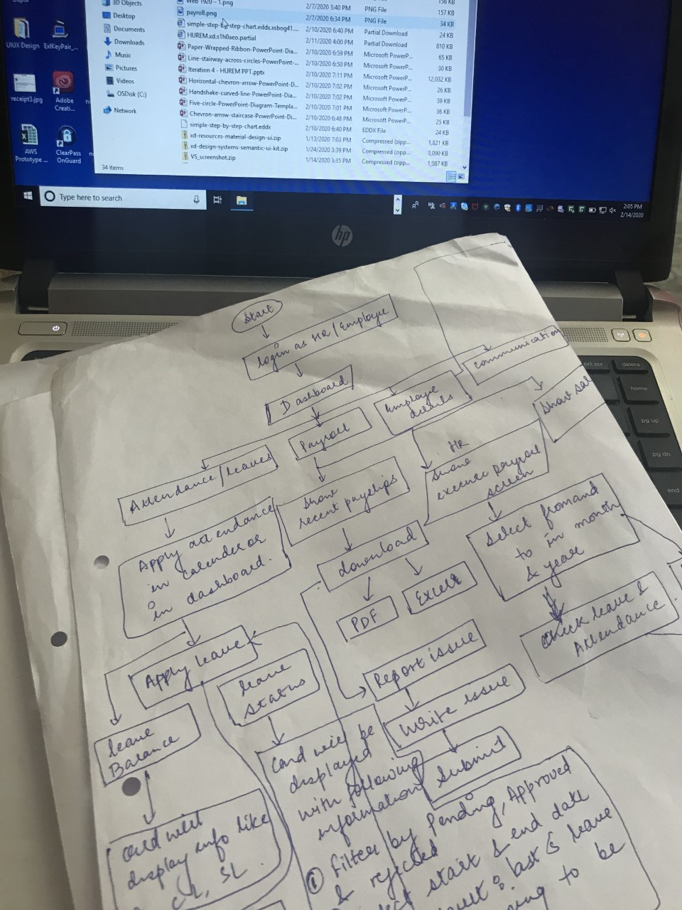
Task Flow
Task flow hard copy

Slide 29
THANKS!
Any quetions?
You can find me at:
user@gmail.com

